Slide 1

Prediction of mean of new observations
Occasionally, we may want to predict the mean of m new observations for a given level of a predictor variable.
For example, suppose the Toluca Company has been asked to bid on a contract that calls for m=3 production runs of X_{h}=100 units.
Management wants to predict the mean work hours for these three lots to be able to predict total work hours to fill the contract.
We denote the mean of the new Y observations to be predicted as

Slide 2

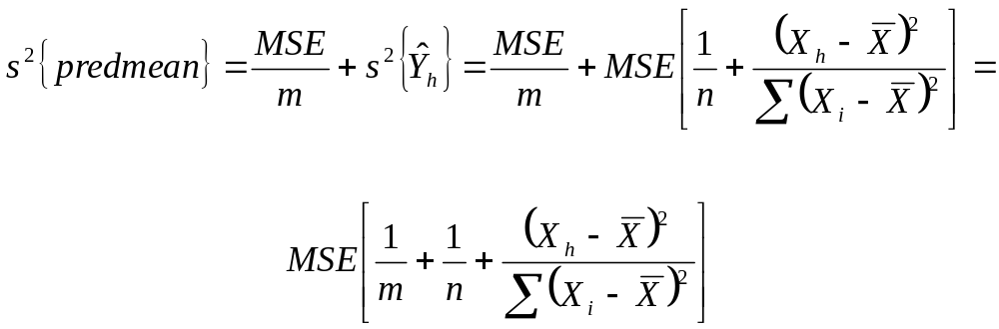
Prediction of mean of new observations
Assuming that the new Y observations are independent, the (1-α)100% prediction interval is
where

Slide 3
Prediction of mean of new observations
The variance of s²{predmean} has two components
The variance of the mean of the m observations from the probability distribution of Y at X = X_{h}: σ²/m.
The variance of the sampling distribution of Y_{h}(hat): σ²{Y_{h}(hat)}. This is the variation in the mean of the distribution of Y at X = X_{h}.
For the Toluca example, calculate the 90% prediction interval for the mean number of work hours in three new productions each with X_{h}=100 (in class).
Y_{h}(hat) = 419.4 s²{Y_{h}(hat)} = 203.72 MSE = 2,384 t(.95,23) = 1.714

Slide 4
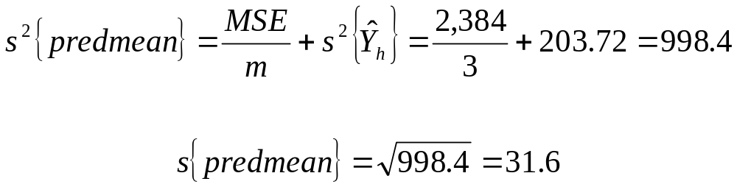
Prediction of mean of new observations
Y_{h}(hat) = 419.4 s²{Y_{h}(hat)} = 203.72 MSE = 2,384 t(.95,23) = 1.714
So the 90% prediction interval for the mean work hours of 3 runs is
This gives (365.2, 473.6)

Slide 5
Prediction of mean of new observations
The prediction interval for the mean work hours for three new lots with lot sizes X_{h}=100 is (365.2, 473.6).
The prediction interval for the number of work hours for a new lot with lot size X_{h}=100 was (332.2, 506.6). The prediction interval for the mean work hours is smaller than for a single lot.
This is due to the fact that the variability in means is smaller than that for single observations.
The variance of the mean of the m observations Y is σ²/m as opposed to σ², the variance of the observations Y.

Slide 6
Confidence Band for Regression Line
At times we would like to obtain a confidence band for the entire regression line E{Y} = β₀ + β₁X
This band enables us to see the region in which the entire regression line lies.
It can be useful for determining the appropriateness of a fitted regression function (which we will see later).

Slide 7


Confidence Band for Regression Line
The Working-Hotelling (1-α)100% confidence band has the following two boundary values at any level X_{h}
where
Note that the formula for the confidence band is the same as the formula for a confidence interval for E{Y} at X_{h}, except the t multiple has been replaced by the W multiple.
Similarly then, the confidence band will be wider the farther X_{h} is from the mean X(bar) since the standard deviation of Y_{h}(hat) is larger.

Slide 8
Confidence Band for Regression Line
Also, the W multiple will be larger than the t multiple, so at any value X_{h}, the confidence band for the regression line will be wider than the confidence interval for just the point E{Y}.
This is a result of the fact that the confidence band must encompass the entire regression line while the confidence interval applies only to a single level X_{h}.
Suppose there is a .5 probability that E{Y} is between 0 and 10 when X=5 (event A) and there is a .5 probability that E{Y} is between 20 and 30 when X=6 (event B).
Assuming independence, what is the probability of both event A and event B?

Slide 9
Confidence Band for Regression Line
The probability of event A and event B is .5*.5 = .25.
So if the confidence band simply connected the dots of the two 50% confidence intervals, this band would only have 25% confidence.
For this entire band to have 50% confidence, the two intervals would need to have at least 71% confidence.
This is conceptually the reason why at any value X_{h}, the confidence band for the regression line will be wider than the confidence interval for E{Y}.

Slide 10
Confidence Band for Regression Line
For example, we wish to determine how well we have been able to estimate the regression function for the Toluca example by obtaining the 90% confidence band for the regression line.
We will illustrate by calculating the boundary values of the confidence band for X_{h} = 100.
Y_{h}(hat) = 419.4 s²{Y_{h}(hat)} = 203.72
W² = 2F(1-α;2,n-2) = 2F(.9;2,23) = 2(2.549)=5.098
W=square root of 5.098 = 2.258

Slide 11
Confidence Band for Regression Line
Thus the boundary of the confidence band for this regression line at X_{h}=100 are
419.4 ± 2.258(14.27) = (387.2, 451.6)
We can use the same approach to calculate the confidence band for this regression line at other values of X_{h}.
Recall that the 90% confidence interval for E{Y_{h}} at X_{h} =100 was (394.9, 443.9), a much narrower range.
The only difference in the formulas, was then we used t(.9,23)=1.714 and here we used W=2.258.

Slide 12
ANOVA approach to Regression
We will know consider regression analysis from the perspective of analysis of variance (ANOVA).
The analysis of variance approach is based on partitioning the sum of squares and degrees of freedom associated with the response variable Y.
We will use the Toluca example to illustrate this point.

Slide 13
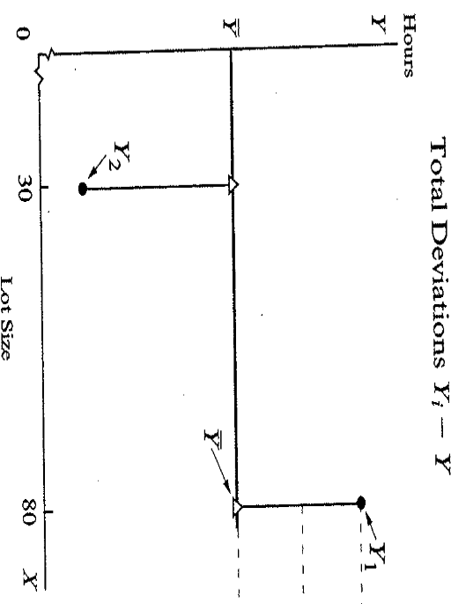

ANOVA approach to Regression
The figure shows the first two observations Y₁ and Y₂. Disregarding lot size, we see there is variation in the number of hours worked.
This variation is conventionally measured in terms of the deviations of the Y_{i} around their mean Y(bar),

Slide 14
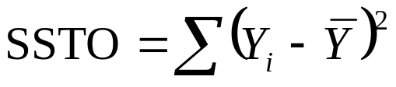
ANOVA approach to Regression
These deviations are shown by the vertical lines. The measure of the total variation, which is denoted by SSTO, is the sum of these squared deviations.
SSTO stands for the total sum of squares

Slide 15
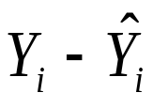
ANOVA approach to Regression
If all the Y_{i} observations are the same, SSTO=0. The greater the variation among the Y_{i} observations, the larger SSTO is.
Thus, SSTO for the Toluca example is a measure of uncertainty of the work hours when the lot size is not taken into account.
After taking into account the predictor variable X, the variation reflecting the uncertainty in the variable Y is that of the Y_{i} observations around the fitted regression line

Slide 16
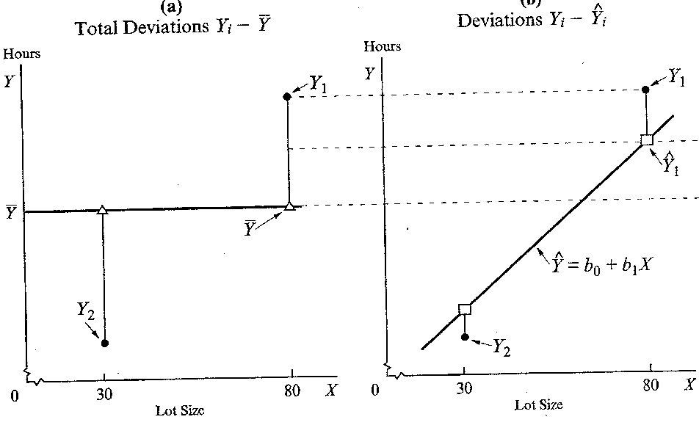
ANOVA approach to Regression
These deviations are shown by the vertical lines in the second figure (b)
The measure of variation in the Y_{i} observations present when the predictor variable X is taken into account is the sum of the squared deviations, SSE. This is the leftover variation after taking into account the predictor variable, that is the unexplained variation.

Slide 17
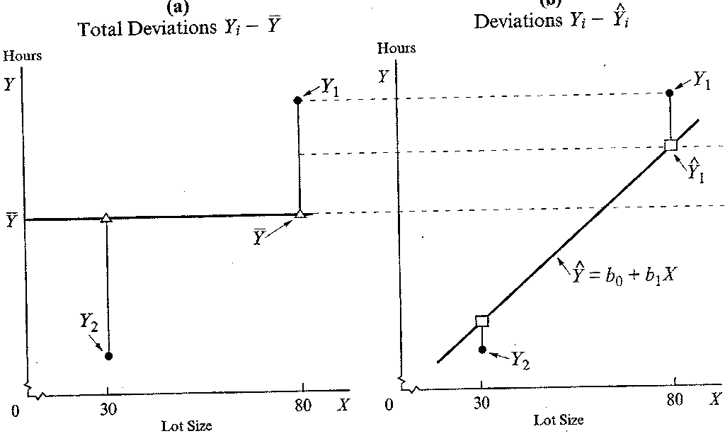

ANOVA approach to Regression
Recall that SSE denotes error sum of squares and we have that
If all the observations fall on the regression line then there is no unexplained variation after taking into account X and SSE=0. The greater the variation of the Y_{i} around the fitted regression line, the worse the fit and the larger the SSE.

Slide 18
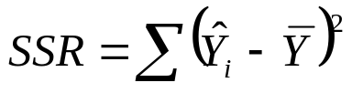
ANOVA approach to Regression
For the Toluca example, we derived previously that
SSTO = 307,203 SSE = 54,825
There is a large difference between these two sum of squares.
The difference is accounted for by the SSR, regression sum of squares, where
The SSR is the sum of squared deviations of the fitted values from the mean of the observations.

Slide 19
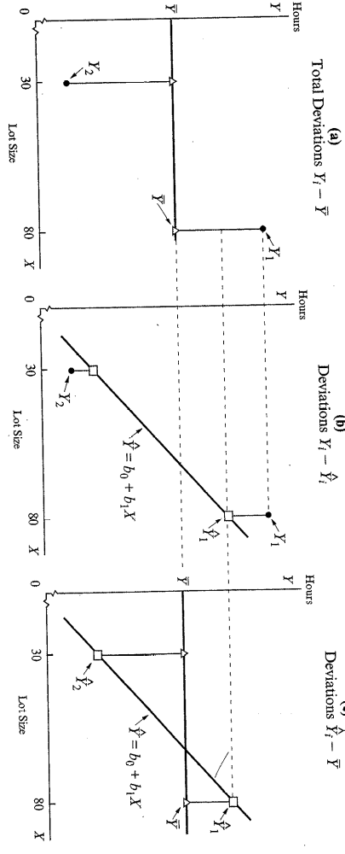
ANOVA approach to Regression
These deviations are shown by the vertical lines in the third figure (c)
The SSR is a measure of the part of the variability which is explained by the regression line, that is the variability that is explained by X. The larger the SSR in relation to SSTO, the greater the effect of X in accounting for the total variation in Y.

Slide 20
ANOVA approach to Regression
It was stated earlier that SSR accounted for the discrepancy between the SSTO and SSE. In general, we have that
SSR = SSTO – SSE or SSTO = SSR + SSE
For the Toluca example,
SSR = SSTO – SSE = 307,203 – 54,825 = 252,378
This indicates that most of the total variability in work hours is accounted for by the relationship between lot size and work hours.

Slide 21
ANOVA approach to Regression
Again, SSTO = SSE + SSR. You can see this in the graphs. The total deviations of the observations from the mean shown in figure (a), SSTO, are equal to the deviations of the observations from the fitted values in figure (b), SSE, plus the deviations of the fitted values from the mean in figure (c), SSR.

Slide 22
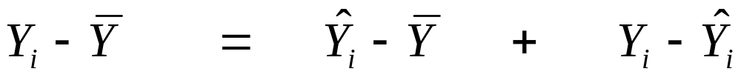
ANOVA approach to Regression
The total deviation Y_{i} – Y(bar), used in the measure of total variation of the observations Y_{i} without taking the predictor variable into account, can be decomposed into two components
1) Variation in Y explained by X (the model).
Total Variation
Deviation of fitted regression value around mean

Slide 23
ANOVA approach to Regression
The total deviation Y_{i} – Y(bar), used in the measure of total variation of the observations Y_{i} without taking the predictor variable into account, can be decomposed into two components
2) Variation in Y not explained by X (the model).
Total Variation
Deviation of fitted regression value around mean
Deviation around fitted regression line

Slide 24
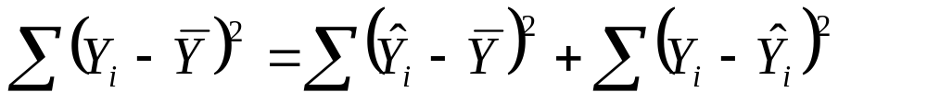
ANOVA approach to Regression
The sums of the squares of these deviations have the same relationship
or
SSTO = SSR + SSE
SSTO is the total variability in the data
SSR is the total variability explained by the X (the regression model)
SSE is the total unexplained variability – the total variability not explained by X (the regression model).

